Slide 1
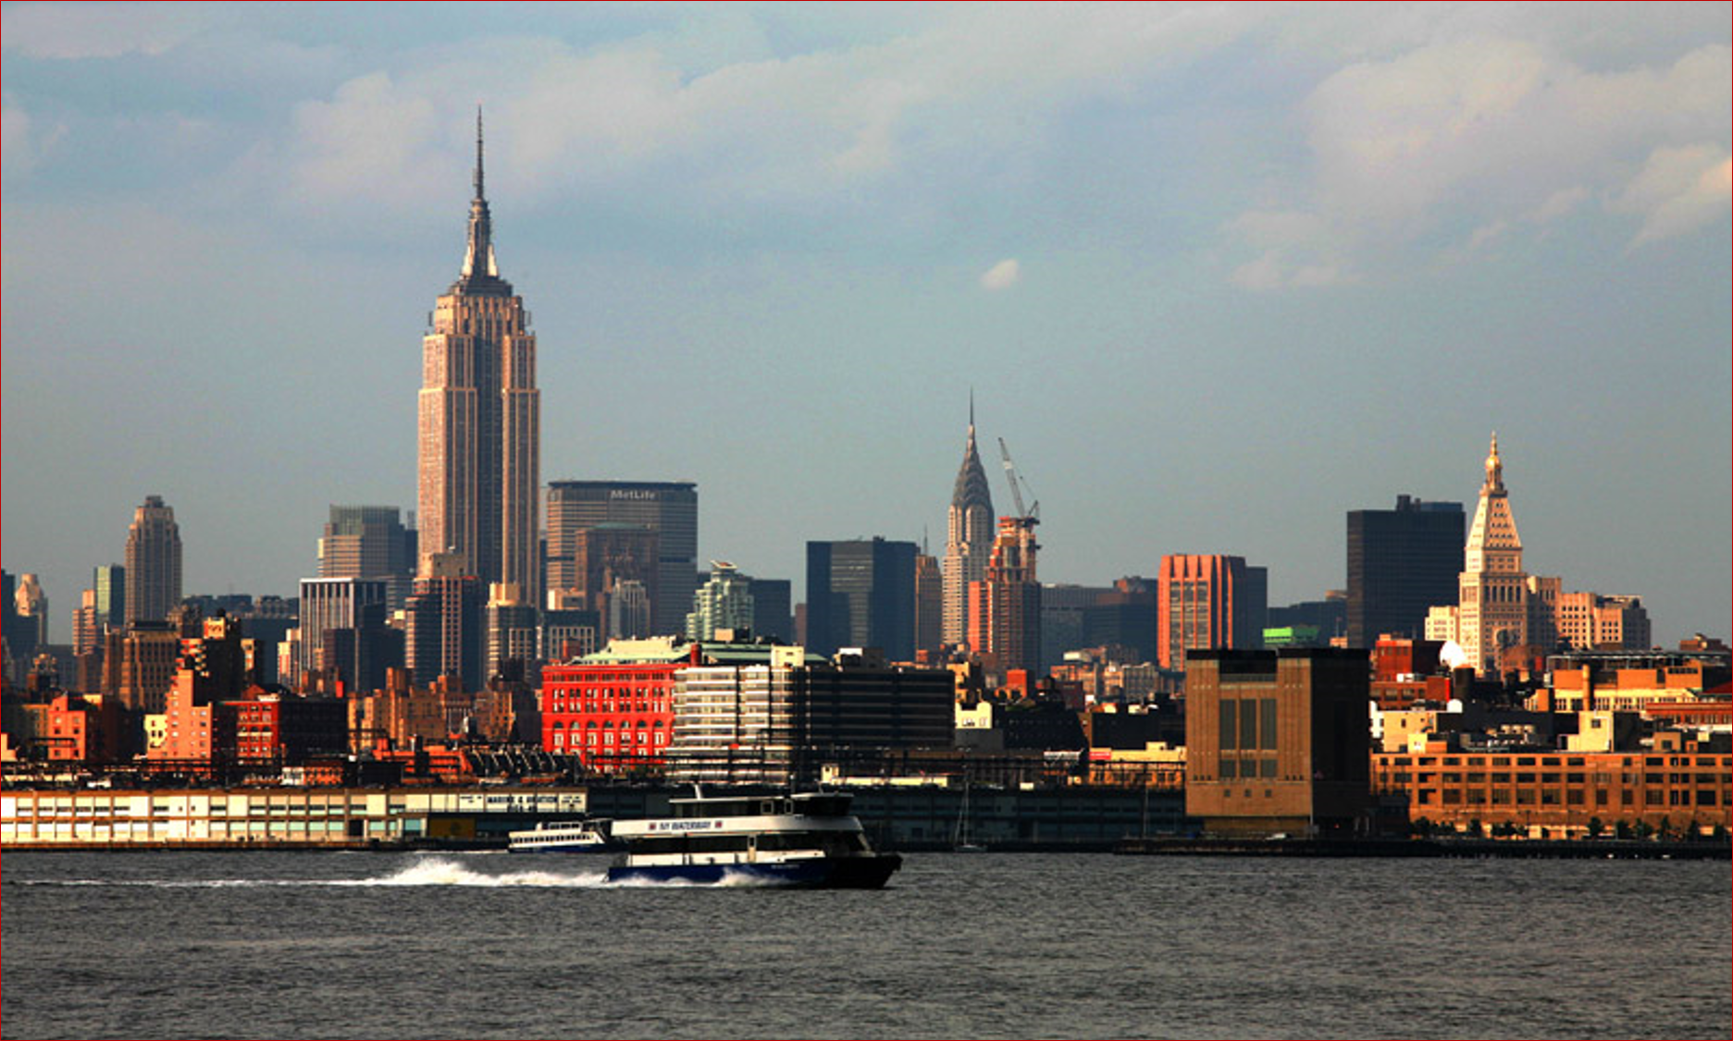
Software Development Paradigm Datafication, Intelligence, Architecturalization and Intensification (DIAI) 软件开发的模式和技术 数据化,智能化,架构化和集约化
|、、，
Haikuan Li, Visiting Professor
CLEBA Group, Delfgauw
The Netherlands
[1] Haikuan Li “Software Development of Datafication, Intelligence, Architecturalzation and Intensification(ppt)”, Lecture Notes on Leading Software Technology, Cleba Group, NL, 2020
Notes:
The title of the course is “Software Development Paradigm in the Era of Big Data”.

Slide 2
Paradigm
“The successive transition from one paradigm to another via revolution is the usual developmental pattern of nature science” – Thomas Kuhn 1962“通过革命从一种范式到另一种范式的不断转变是自然科学通常的发展模式。”–托马斯·库恩（1962）
Paradigm: In science and philosophy, a paradigm (/ˈpærədaɪm/) is a distinct set of concepts or thought patterns, including theories, research methods, postulates (假设), and standards for what constitutes legitimate contributions to a field. [wiki]

Slide 3

Software Reuse in-the-Very-Large Software Development with Datafication
Haikuan Li, Visiting Professor
CLEBA Group, Delfgauw
The Netherlands
[1] Haikuan Li “Software Development of Datafication, Intelligence, Architecturalzation and Intensification(ppt)”, Lecture Notes on Leading Software Technology, Cleba Group, NL, 2020
Notes:
The title of the course is “Software Development Paradigm in the Era of Big Data”.

Slide 4
Very Large Scale Software Reuse 超大规模软件复用
The shift from small-scale software reuse to large-scale software reuse can improve the efficiency and quality of software development by orders of magnitude; and the shift from large-scale software reuse to very- large-scale software reuse will move software development from traditional workshop to industrial production.
从小规模软件复用到大规模软件复用的转变，可以成数量级地改进软件开发的效率与质量；而从大规模软件复用到超大规模软件复用的用转变，将使软件生产从传统作坊走向工业化的生产模式。

Slide 5
The Drive to Reuse
“The drive to create reusable rather than transitory artifacts has aesthetic and intellectual as well as economic motivations and is part of man's desire for immortality. It distinguishes man from other creatures and civilized from primitive societies.” “Reusability is a central concept in life-cycle technology, In system evolution, and in the development of theories and models.”
“创造可重复而非一次性使用的人工制品的动力不仅来源于人类审美、智慧与经济的动机，而且也是人类追求不朽的一部分。它是区别人类和其它生物以及文明和蒙昧的标志。”“可重用性是生命周期技术、系统演化以及理论和模型研发中的核心概念。
----Peter Wegner, 1984

Slide 6
Software Reuse
Software reuse is the use of existing software, or software knowledge, to build new software. [wiki] **
Software reuse is the use of any existing software resources to build new software. software resources refers to any artifacts or knowledge generated during software development, maintenance and operation. [HLI]
** Frakes, W.B.; Kyo Kang (July 2005). "Software Reuse Research: Status and Future". IEEE Transactions on Software Engineering.
Notes:
any

Slide 7
"our civilization runs on software.“
---Bjarne Stroustrup
Software Era?
Era refers to a period of time marked by some events or changes which are important worldwide[wiki] .
Big requirements
Big resources
available
Advanced Technologies available
Artificial
Intelligence
era
Big Data era
Because of
Internet era
Software
era?
Soft-ware
Information era
… era
Cloud Computing
era
Notes:
(点击鼠标)
What is era?
(点击鼠标)
Era refers to a period of time marked by some events or changes which are important worldwide historically [wiki].

Slide 8
A software era is on the way to us
And such a huge presence is also a tremendous data resource, a complex, diverse and knowledge-intensive and capital-intensive resource. This huge amount of resources may change the shape of software engineering.
With the rapid growth of software requirements, and the accumulation and efficient use of software resources, the degree of intensification and automation of software production will rapidly increase, and the substantial improvement in software production quality and efficiency will be possible. A software era is approaching, man‘s way of life and the whole world will undergo tremendous changes.
Big Requirements
Software Era
Big Resources
New Technology

Slide 9
Similar View：Software Defined Era
From the perspective of infrastructure, this is an Internet + era; from the perspective of computing mode, this is an era of cloud computing; from the perspective of information resources, this is an era of big data; from the perspective of information applications, this It is the age of intelligence. I want to say that there is a very important technology in these, and that is software. In a sense, our era is a software-defined era. -Mei Hong，2017
“从基础设施的视角来看，这是一个互联网+时代；从计算模式的视角来看，这是一个云计算时代；从信息资源的视角来看，这是一个大数据时代；从信息应用的视角来看，这是智能化时代。我想说在这些里面有一项很重要的技术，那就是软件。某种意义上来说，我们这个时代就是一个软件定义的时代”。- 梅宏
梅宏，“软件定义的未来，万物皆可互联，一切均可编程”， 大数据文摘（Big Data Digest）， 2017-11-04 https://cloud.tencent.com/developer/article/1134886
Hong Mei, “Several Understandings and Reflections on the Challenges of Software Technology in the Age of Big Data”, China Computer Society Newsletter, Vol. 9, No. 12, Dec. 2013
Hong Mei, "Software Defines Everything - Opportunities and Challenges", 14th China Computing Conference (CNCC2017), May 25, 2017, Fuzhou, China

Slide 10


What is data?
Data is normally known as information carrier.
Autumn is
coming！
Information carrier
If data is defined this way, as information carrier only, may I ask, what is not information carrier or what is not data in the universe?
If everything is data, how could we deal with it?
Information
In the matter of fact, the data, especially the big data, normally refers to only the symbolized or digitalized information.
This is perhaps why so many companies and organizations, nowadays, busy with digitalization,
This is because that computers can process the digitalized data only.

Slide 11
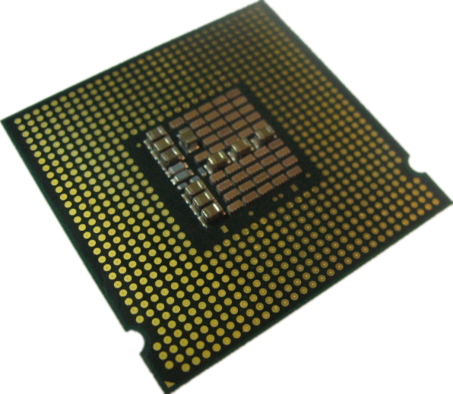
Software-As-Data
Software is normally used to process data, The fact is typically reflected in data flow diagram that are used for software development.
However, software is also data, especially when we use program to process program.
Compiler, a typical example
Target code
Software source code
The software being processed is actually data.

Slide 12
Software-As-Big-Data
To a data engineer, every thing is data. If not, digitalize it.
To a software engineer, every thing is software. If not, define it.
Any artifacts generated during software development, maintenance and even operation, which could be in textual，graphical or any other formats.
Any running systems especially, the services in the internet can also been viewed as software resources, they are digitalized and accessible, e.g. a mobile is a service in the wireless network.
Software Defined Everything
Software components may not
necessarily be software Intensive,
the hardware intensive ones as well.
Internet of Every Thing
Internet is a large system that consists of enormous software defined elements. This is why software as big data.
"Big Data is high-volume, high-velocity and/or high-variety information assets that demand cost-effective, innovative forms of information processing that enable enhanced insight, decision making, and process automation.” –Gartner 2012

Slide 13
Software Reuse
Software Reuse in the Small
Software Reuse in the Large
Software Reuse in the Very Large

Slide 14
Development of software reuse technology
Small Reuse
Large Reuse
Very Large Ruse
Reuse-in-the-Small: reuse small code components.
Reuse-in-the-Large: reuse large grain components and more importantly design information[HLi-1993].
Reuse in the Very Large: Strategically, reuse any artifact that is software accessible.
Software intensive + Hardware intensive components, e.g. cps
Any available software processes e.g. service, mobile, PC etc.
Software Defined Everything (SDE)

Slide 15
Software Reuse in the Small
Reusing Small Code Components, such as Procedures, Classes, Packages, etc.
Component Library: A collection of source code components used by computer programs for software development.
Component Retrieval: To search the most relevant component from a large number of components present in the repository so that retrieved component can be reused.

Slide 16
Software Reuse in the Large
Large-scale Reuse: Reuse large grain components and more importantly design information.
Large-grain components: Subsystem or even system
Design Information: concepts, architecture, design
Strategic Reuse: Reusing the knowledge about software development strategy: e.g. project plan, budget, experience etc.

Slide 17
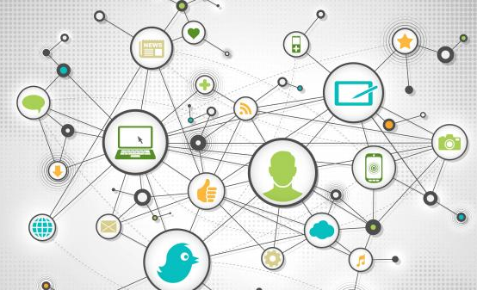
Software Reuse in the Very Large
We often say "software as a service," or "service is software," because services, even when running online, can be used to build new software as part of software resources.
Software
服务
Software
Software
服务
Service
Software
Software
Service
Software
Software
Service
Software
Software resources can be scaled to include any software-defined object, such as every PC that is connected to the internet, a cellphone that is connected to wireless internet, a taxi with taxi software, and a cyber physical system. Furthermore, the concepts of Software-Defined Everything (SDE) and Internet of Everything (IoE) make us see the huge demand for software in the future and the great potential of software.

Slide 18

Two Kinds of Software Resources
Software resources
Static resources
Active (dynamic) resources
Software resources in static status refer to all the software resources in the form of source code and documents, for both new and legacy systems.
Software resources in active (dynamic) status refer to all the
Running systems
Web Services including PC, mobile, CPS etc.
Software defined things

Slide 19
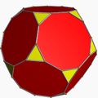
The Static Resources
Close-Source Software (CSS)
Close-Source Software may be reused to develop similar systems with better quality and functionality for a company or organization, for example for
Software architecture
Design, Source code, Document
Budgets ,Schedules, Work plan
Requirements , Domain model
Requirements analysis
Performance engineering
Test plans, test cases, test data
System redesign, Reengineering,
Re-architecting or
Additive and Perfective maintenance.
Open-Source Software (OSS)
OSS is computer software, the source code of the software is available with a license, according to the license, the copyright holder provides the rights to study, change, and distribute the software to anyone and for any purpose [wiki]..
In 2002, about 200,000 open-source projects representing over 4.9 billion LOC [OSS 2008];
In 2014, Facebook alone has 9.9 million lines of code (LOC) open [ZD Net].
In 2014 the amount of open sources as appearing in the version control systems on internet is estimated 70TB [CCCF 2014].

Slide 20
The Active Resources
Running Systems refer to especially the large and complex systems worldwide that are in use in companies and organizations. The running systems may be reused for system development easily if the functionality of the systems could be delivered to users via internet web services.
Web Services refers to all the services available in internet. In 2013, the servers owned by Google alone is over 2.4 million. The services at website are likely to be used to develop new services or applications. This is rather active especially after SOA (Service-Oriented Architecture) was introduced in 1996. The potentials service reuse may be well specified in the formula as follows.
The formula shows a new way of software development, as services is a very high-level system component, the complexity about the implementation, maintenance and even operation of the services Are hidden from the system developers.
Software-defined things in the internet or Intranet
Software system = Service-oriented architectures + Services

Slide 21
Active Software Components
1960s
Subroutines
1970s
Modules
1980s
Objects
1990s
Components
2000S
Services
2010s
SDTS
Static Components
Active Components

Slide 22

Software Resources
Active Software
Resources
Gold Mine
Software Defined Everything
Services
Static
Resources
Capital Intensive
& Knowledge Intensive Resources
Internet of Everything

Slide 23
The Management of Global Software Resources
Search Engine
Recommendation Engine
Software Data Mining Toolkits
Crowdsourcing System
Service-Layer
Management-Layer
Resources
Acquisition
Resources
Management
Resources
Delivery
Resources-Layer
Open
Resources
Software Defined Things
Mobile Services
Closed
Resources
Internet
Services
App

Slide 24
Software Resources Management
Global
Software Resources
Industry
Resources
Software Product Lines
Field
Resources
Industry
Resources
Domain Resources
Field
Resources
Domain Resources
......
......
......
Domain Resources
Industry
Resources
Field
Resources
Cluster: A set of
highly interrelated active components

Slide 25
Software Development in the Era of Big Data
Software Products
Global Software Resources
Intensive Development
Domain Management
Reusable
Artifacts
服
务
层
搜索
引擎
推荐
引擎
数据挖掘
工具包
众包
平台
Software
Mining
Reusable
Artifacts
Domain Management
Software Products
Software Mining
Reusable
Artifacts
Reusable
Artifacts
Intensive Development
管
理
层
资源
获取
资源
管理
资源
提交
。。。。
Software Products
。。。。k
Reusable
Artifacts
Reusable
Artifacts
。。。。
资源层
开放资源
软件定义资源
移动
服务
物联
资源
非开放资源
互联网服务
App
Domain Management
Intensive Development
Software Products
Software Mining
Reusable
Artifacts
Reusable
Artifacts
Fig. Low-Code /No-code Development Platforms &
Software Product Lines

Slide 26
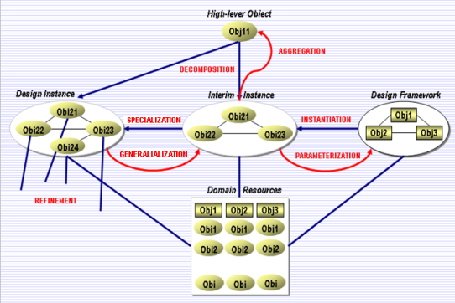
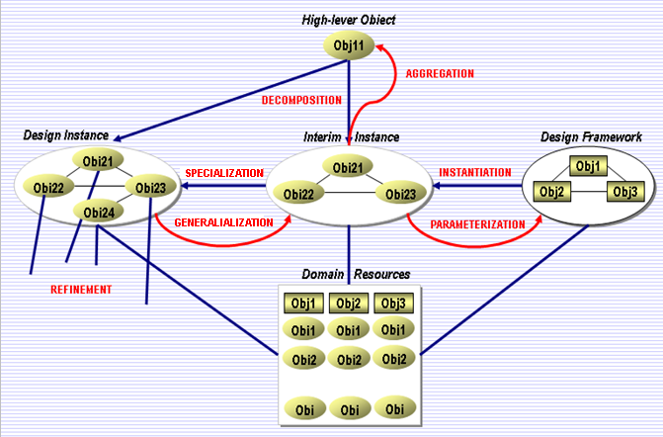

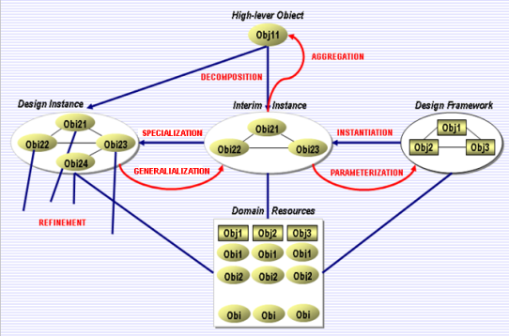
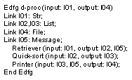
Software Product Lines / Low-Code Platforms
New
Systems
Global Software Resources
Software Data Mining
Domain
Resources Management
Intensive
Software Development
Reusable
Artifacts
Reusable
Artifacts
Software Data Mining
Organization Model
Operational Model
Reusable Artifacts
Reusable Artifacts
Reusable Artifacts
Reusable Artifacts
User Interface
Software mining
Legacy Systems
Legacy Systems

Slide 27
Low-Code Development Platforms (LCDP)
Organizations are increasingly turning to low-code application platforms to modernize legacy processes and quickly deliver new, digital customer experiences. --Gartner’s report
LCDP provides a development environment used to create application software through a graphical user interface. A low-coded platform may produce entirely operational applications, or require additional coding for specific situations.
LCDP is software engineering methods, tools and techniques for creating a collection of similar software systems from a shared set of software assets using a common means of production
Example, Google App Engine is a cloud computing platform as a service for developing and hosting web applications in Google-managed data centers.
Technology：Graphical User Interface，Application Generator，Software Reuse.
Refer：Richardson, Clay (June 9, 2014). "New Development Platforms Emerge For Customer-Facing Applications". www.forrester.com. Retrieved 18 November 2016.

Slide 28
The Low-Code/No-Code Movement
Richardson, Clay (June 9, 2014). "New Development Platforms Emerge For Customer-Facing Applications". www.forrester.com. Retrieved 18 November 2016.
Lonergan, Kevin (29 July 2015). "On the down low: Why CIOs should care about Low-code - Information Age". Information Age. Information Age. Archived from the original on 2 February 2017. Retrieved 22 January 2017.
Marvin, Rob (12 August 2014). "How low-code development seeks to accelerate software delivery - SD Times". SD Times. San Diego Times. Retrieved 18 November 2016.
Bloomberg, Jason. "The Low-Code/No-Code Movement: More Disruptive Than You Realize". www.forbes.com. Retrieved 20 August 2018.
Marvin, Rob. "Building an App With No Coding: Myth or Reality?". PCMAG. PC Mag. Retrieved 18 November 2016.
"Software developers: We're on board with low-code (Or even no-code) tools". ZDNet.
Richardson, Clay. "Vendor Landscape: The Fractured, Fertile Terrain Of Low-code Application Platforms" (PDF). Forrester Research. Archived from the original (PDF) on 2017-08-09. Retrieved 2017-01-25.
Hammond, Jeffrey. "The Forrester Wave™: Mobile Low-Code Platforms For Business Developers, Q3 2018". www.forrester.com. Forrester Research. Archived from the original on 15 August 2018. Retrieved 8 August 2018.
Rubens, Paul (10 November 2014). "Use Low-code Platforms to Develop the Apps Customers Want". CIO. CIO Magazine.
Mannaert, Herwig; Verelst, Jan; De Bruyn, Peter (2016). Normalized Systems Theory: From Foundations for Evolvable Software Toward a General Theory for Evolvable Design. ISBN 9789077160091.
Rymer, John. "Low-Code Platforms Deliver Customer Facing Apps Fast, But Can They Scale Up?". Forrester Research. Archived from the original on 2 February 2017. Retrieved 22 January 2016.

Slide 29

Q&A-问答
New
Systems
Domain Resources
Management
Global Software Resources
Software Data Mining
Intensive Software
Development
Reusable
Artifacts
Reusable
Artifacts

Slide 30
Q&A: Very-Large-Scale Software Reuse
Why software era is on the way to us?
What is data?
Why software is data?
Why software could be big data?
What are the two types of software resources?
What is the difference between software reuse in the small and in the large?
What is the difference between software reuse in the large and in the very large?
What is the content of global software resources?
Mention 3 functions of the global software resources management (GSRM).
What is the so-called Low-code/No-code Movement?

